Slide 1


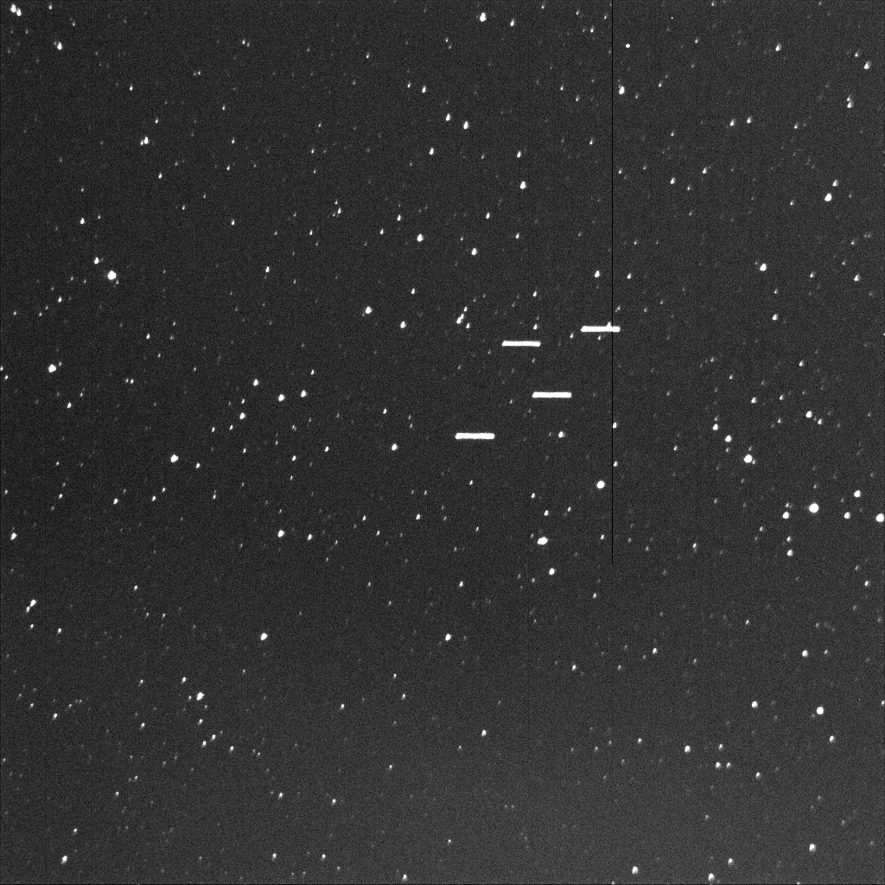

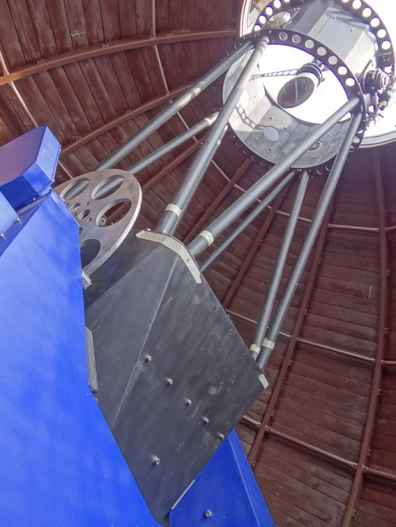
Optical observations
FOV = 29'x 29’ AGO 70cm
FOV = 29'x 29’ AGO 70cm
Direction of GEO motion
Direction of star motion
Figure – Images acquired by AGO 70-cm telescope. Astra satellites are showed on both panels. On the left, during exposure the sidereal tracking was ON and the satellites on GEO are displayed as streaks and stars as points. On the right, during exposure the sidereal tracking was OFF (for GEO equivalent to GEO tracking) so the objects appear as points and stars appear as streaks. The 5s exposure time was used in both cases. The clear (left) and I filter (right) were used.

Slide 2
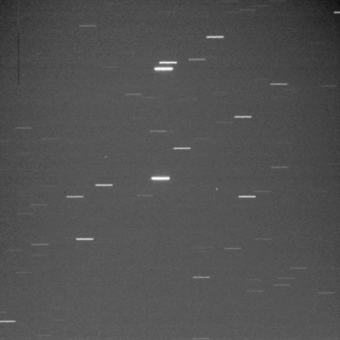
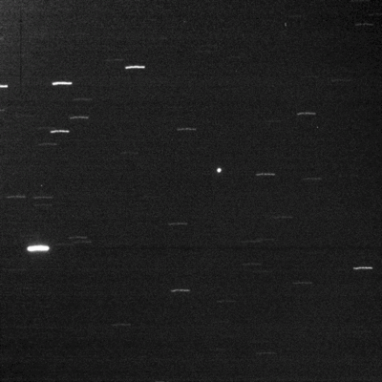
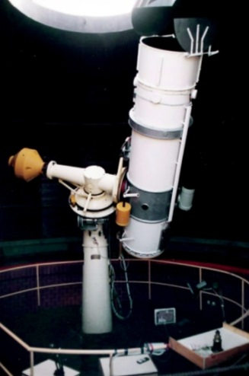
Optical observations, survey
FOV = 24.7’x 24.7’ AGO 60cm
FOV = 24.7’x 24.7’ AGO 60cm
Figure – Images acquired by AGO 60-cm telescope. During exposure the sidereal tracking was OFF and the fragment of Titan 3C transtage (68081G) on GEO is displayed as point and stars as streaks. The 5s exposure time was used in both cases. No filter has been used.
Figure – Images acquired by AGO 60-cm telescope. During exposure the sidereal tracking was OFF and the satellite Express AM-1 (04043A) on GEO is displayed as point and stars as streaks. The 5s exposure time was used in both cases. No filter has been used.

Slide 3
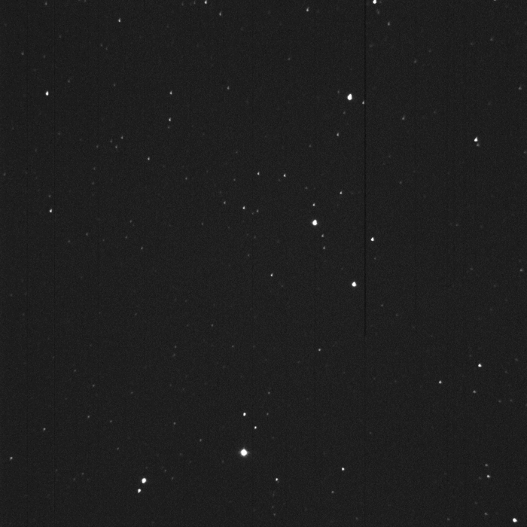
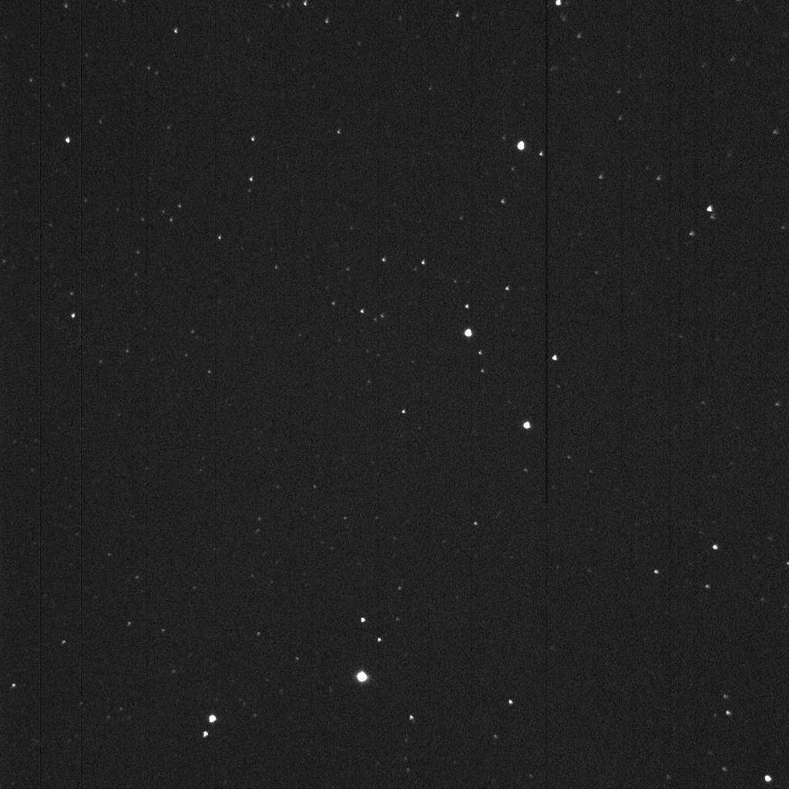
Optical observations, astrometry
FOV = 29'x 29’ AGO 70cm
FOV = 29'x 29’ AGO 70cm
13034A
Direction of motion
Figure – Images acquired by AGO 70-cm telescope. Astrometric observations of satellite IRNSS-1A (13034A). Other four GEO satellites crossing the FOV. Used exposure time was 0.2 s.

Slide 4
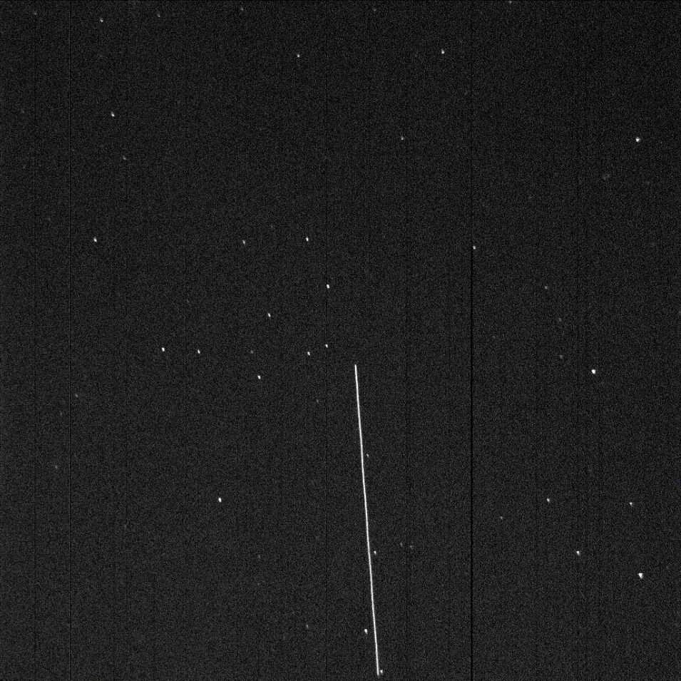
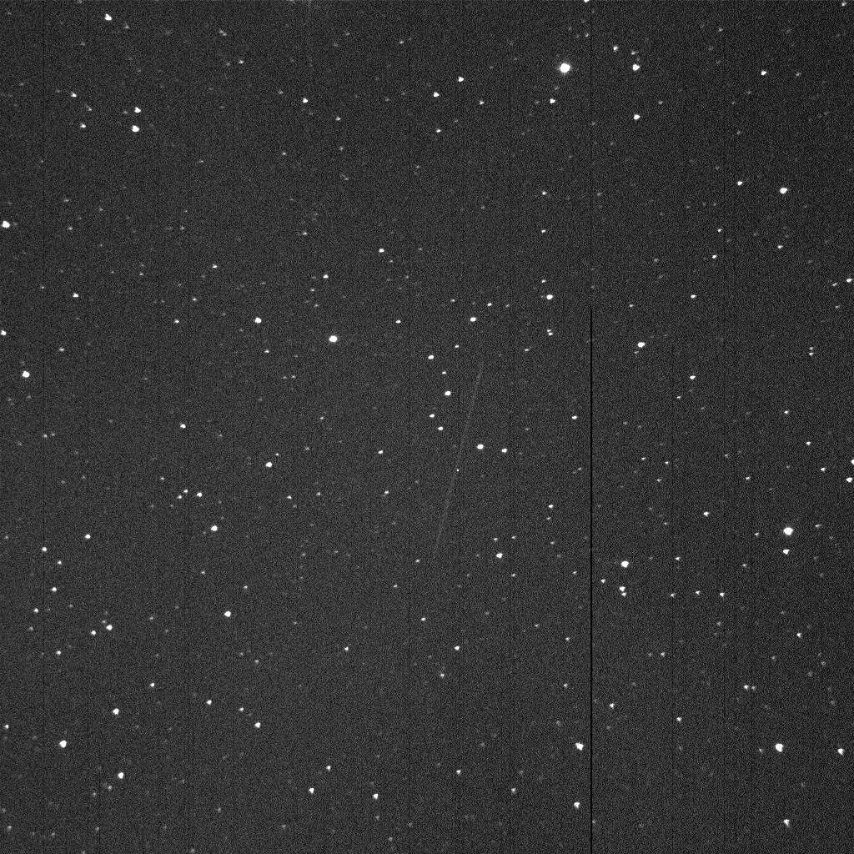
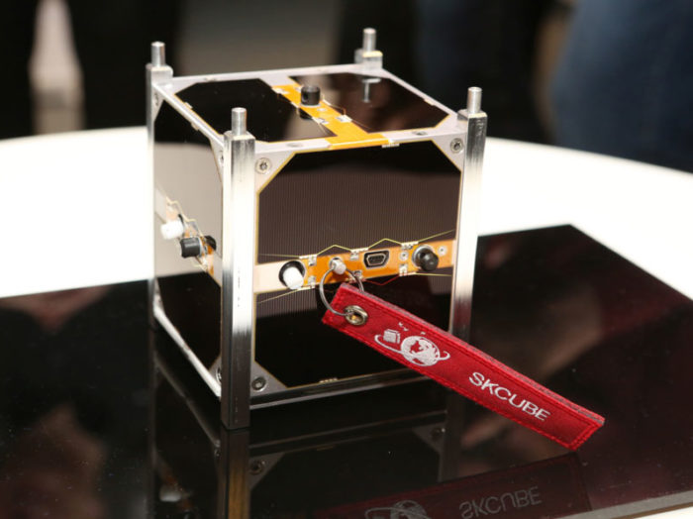
Optical observations, astrometry
FOV = 29'x 29’ AGO 70cm
FOV = 29'x 29’ AGO 70cm
Credit –skcube.sk.
Direction of motion
range = 1027 km
phase = 72.3deg
vel_ang = 0.27deg/s
range = 700 km
phase = 46deg
vel_ang = ~0.5deg/s
Figure – LEO defunct satellite COSMOS 1802 (86093A) acquired by the AGO 70cm telescope. Field RA=18:20:39.57 and DEC=+48:52:33.3 observed at 2017-06-23T21:45:00.14 with ‘Clear’ filter, exp = 0.5s and sidereal tracking ON.
Figure – LEO cubesat SKCube (17036AA) acquired by the AGO 70cm telescope. Field RA=18:0:22.21 and DEC=+02:40:49.3 observed at 2017-08-01T19:49:00 with ‘Clear’ filter, exp = 0.2s and sidereal tracking ON.

Slide 5
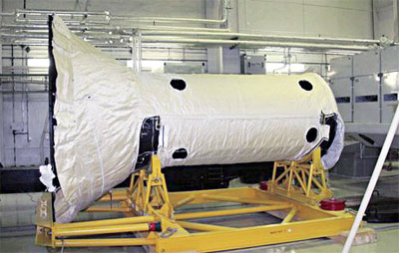
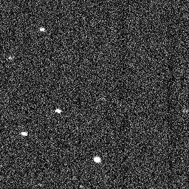
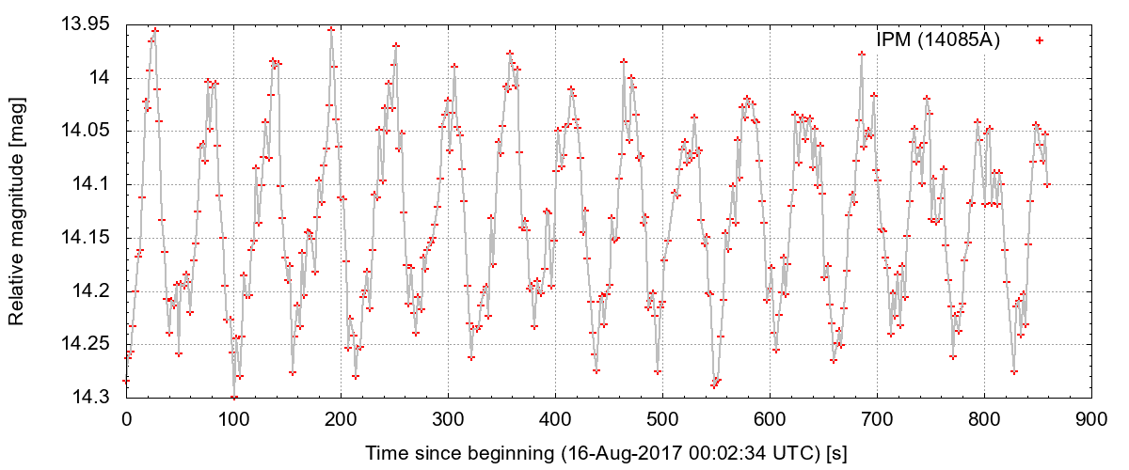
Optical observations, light curves
Figure – Photometric measurements acquired by AGO 70cm telescope (left) and the constructed light curve (right) for the object Dummy IPM (14085A).

Slide 6
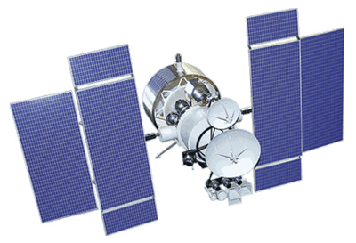
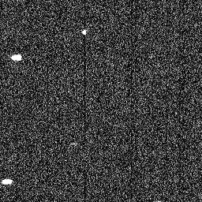
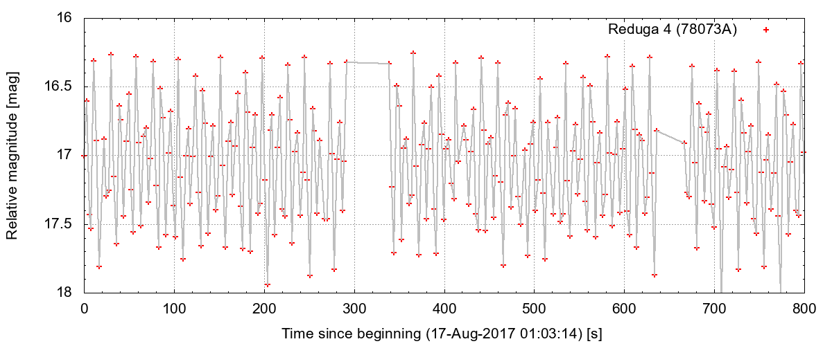
Optical observations, light curves
Figure – Photometric measurements acquired by AGO 70cm telescope (left) and the constructed light curve (right) for the satellite Reduga 4 (78073A).

